Slide 1
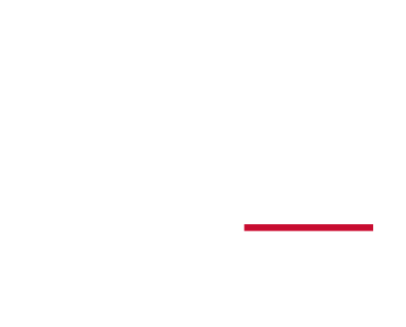
Toward High-Fidelity Digital Twin Technology
Presented by Chenyu Wang
4/10/2023

Slide 2

Background
Digital technologies, are receiving increasing attention from a variety of fields.
all or parts of existing physical assets are converted to digital ones, or new things are directly created in virtual space;
A digital space of this sort 1) represents and models 3D objects 2) reveals how different assets interact with each other.

Slide 3
High-fidelity Digital Twin Creation
The proposition of Digital Twin (DT):
The goal of Creating High-fidelity DT in the Virtual Space is to
Improve the understanding on the given real-world mechanism
Argument the decision-making policy in the real tasks

Slide 4
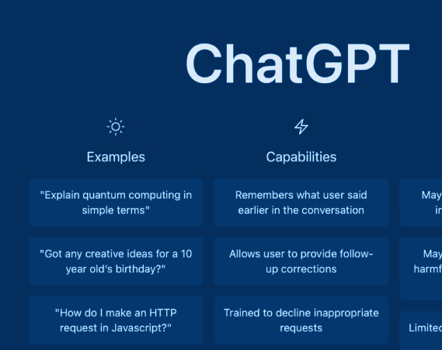
ChatGPT – A digital twin of broad concept
A digital twin agent of your personal life assistant knowing almost everything

Slide 5
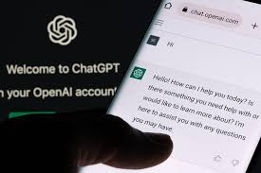
ChatGPT
My question : Are you a digital twin?
Replied by ChatGPT:
Yes, in a sense, I can be considered a digital twin. A digital twin is a digital replica or simulation of a physical object or system, and in my case, I am a digital replica of a language model.

Slide 6
ChatGPT
Trained on a large corpus of text data
Understand and generate text in a variety of formats and styles.
Capabilities include
answering questions,
providing information,
generating text,
completing sentences,
and even carrying on a conversation with a user.
Is this enough?
No, it is a very general usage. Or we say the fidelity is low.

Slide 7
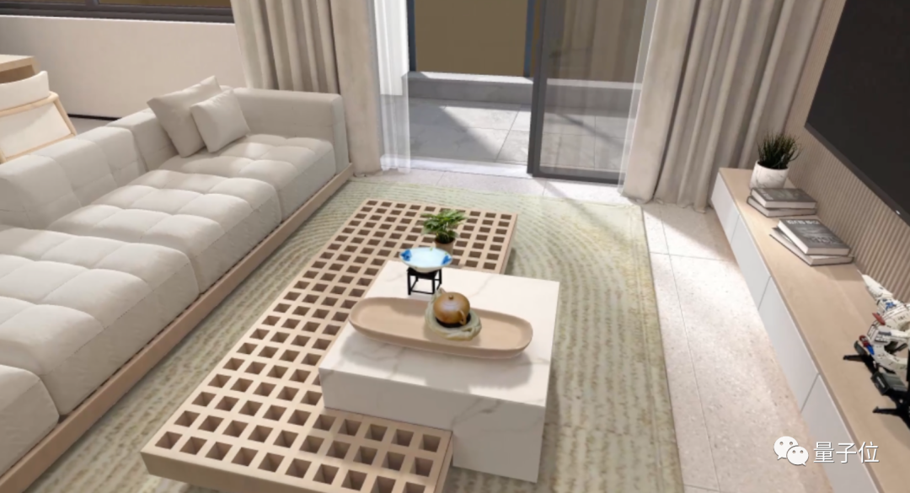
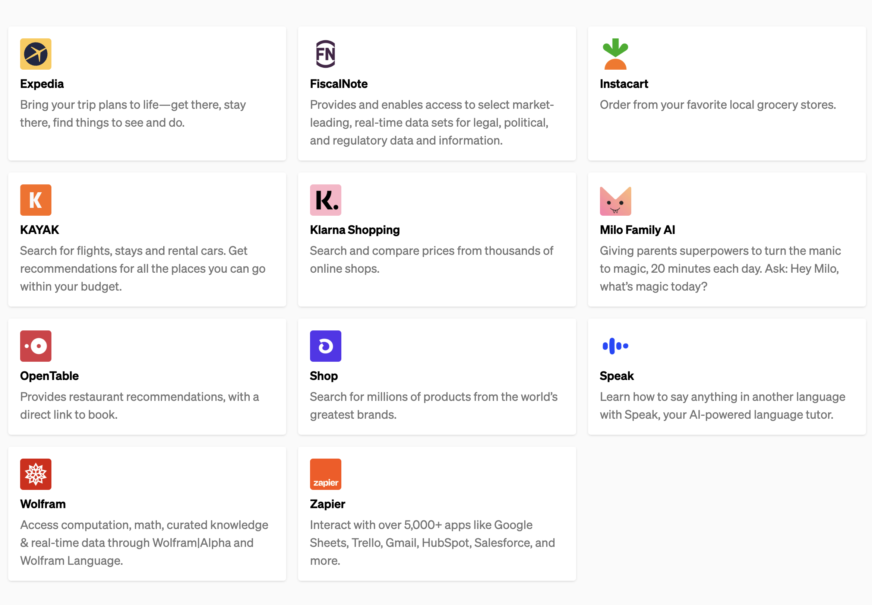
ChatGPT – More possibility
A digital twin of your personal life assistance with different plugins
Neural Radiance Fields - generate large-scale 3D scenes and finely-detailed objects, opening up new possibilities for the metaverse and virtual-real integration applications. (by SenseTime)
https://openai.com/blog/chatgpt-plugins

Slide 8
Limitation towards high-fidelity digital twins
Not enough data to reveal the mechanism
Incomprehensive feature representation of Physical Twin;
Data are owned by different parties that are hard to accumulated;
Few data samples
Noisy data
Data are outdated
Low sampling rate
Communication resources limitation

Slide 9
Not enough data
Data argument
Data synthesis
Denoising / correction
Model aggregation
Data quality of digital twin
Reorganized based on the Source: 1. https://lilianweng.github.io/posts/2022-04-15-data-gen/
2. https://lilianweng.github.io/posts/2022-02-20-active-learning/

Slide 10
Not enough data - Data Argumentation
Types of data
Images
Basic Image Processing Operation: crop, distortion, flip, etc.
Task-Specific Augmentation Strategies (intelligent argumentation)
Image mixture
Text
Lexical Edits ( e.g., operation on words and their synonyms)
Mixup
Audio
Mixup
Masking
Frequency Shift/masking

Slide 11
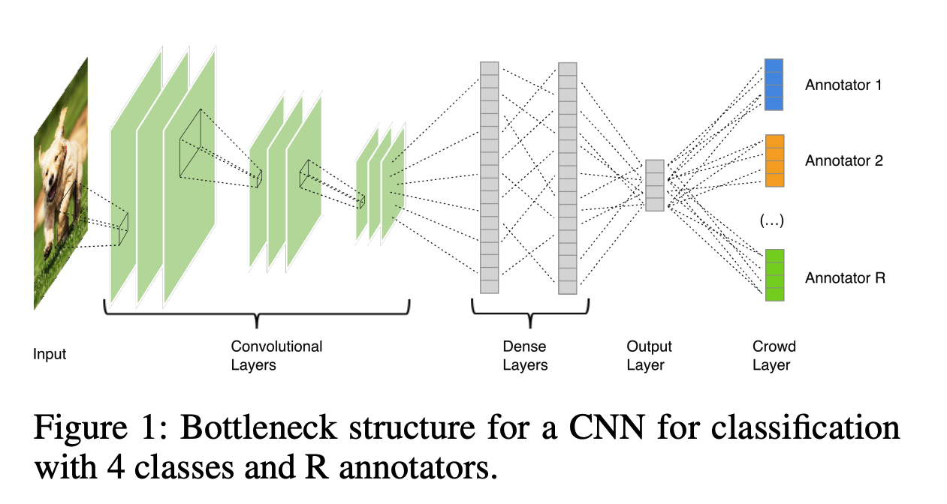
Not enough data - Data Synthesis
Learning from crowds
Includes a crowd layer – represented by matrices
Gradients in of each annotator are aggregated and backpropagated to the bottleneck layer.
Rodrigues, Filipe, and Francisco Pereira. "Deep learning from crowds." Proceedings of the AAAI conference on artificial intelligence. Vol. 32. No. 1. 2018.

Slide 12
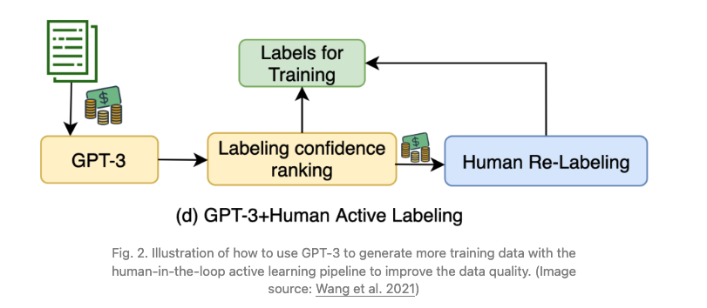
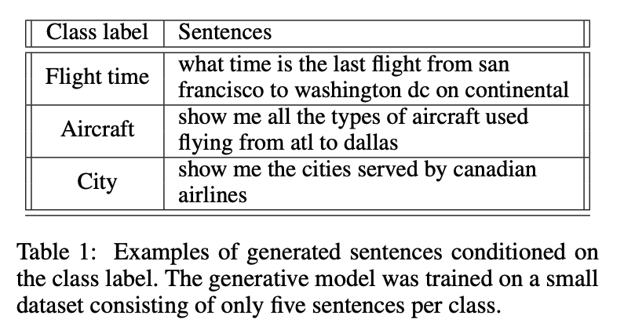
Not enough data - Data Synthesis
Leveraging Language Model as Noisy Annotator / Generator
10x cheaper than human labeling
Self-training
Wang, Shuohang, Yang Liu, Yichong Xu, Chenguang Zhu, and Michael Zeng. "Want to reduce labeling cost? GPT-3 can help." arXiv preprint arXiv:2108.13487 (2021).
Anaby-Tavor, Ateret, et al. "Do not have enough data? Deep learning to the rescue!." Proceedings of the AAAI Conference on Artificial Intelligence. Vol. 34. No. 05. 2020.

Slide 13
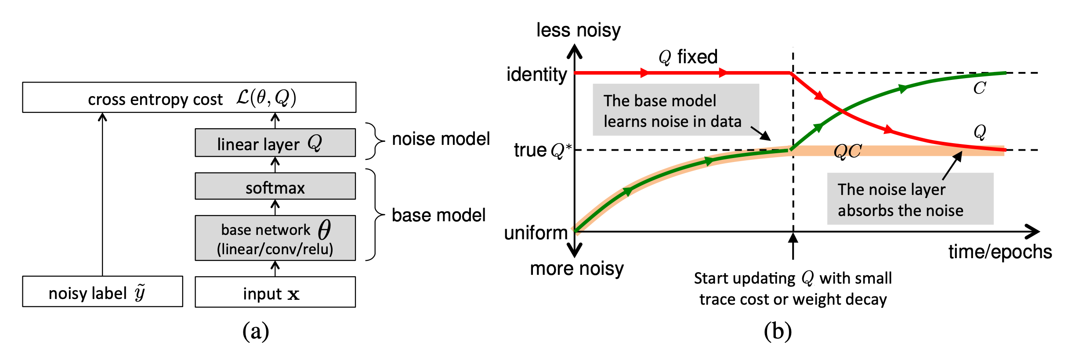
Not enough data - Denoising / Correction
Evaluation:
Regularization and Robust Architecture
Special Structure of Loss function
MAE (mean absolute error)
GCE (generalized cross entropy)
Zero-one loss
Noise pruned curriculum loss

Slide 14
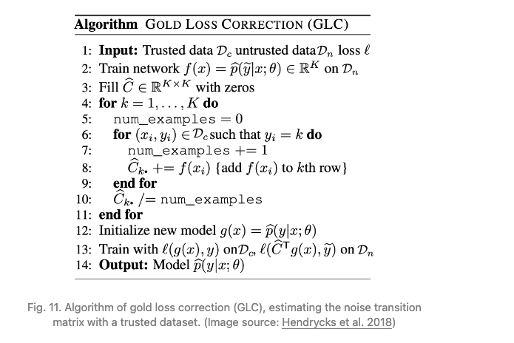

Not enough data - Denoising / Correction
Correction:
Noise transition matrix (Confusion matrix) update loss with correction
Sampling Reweighting and selection
Li, Yuncheng, et al. "Learning from noisy labels with distillation." Proceedings of the IEEE international conference on computer vision. 2017.

Slide 15
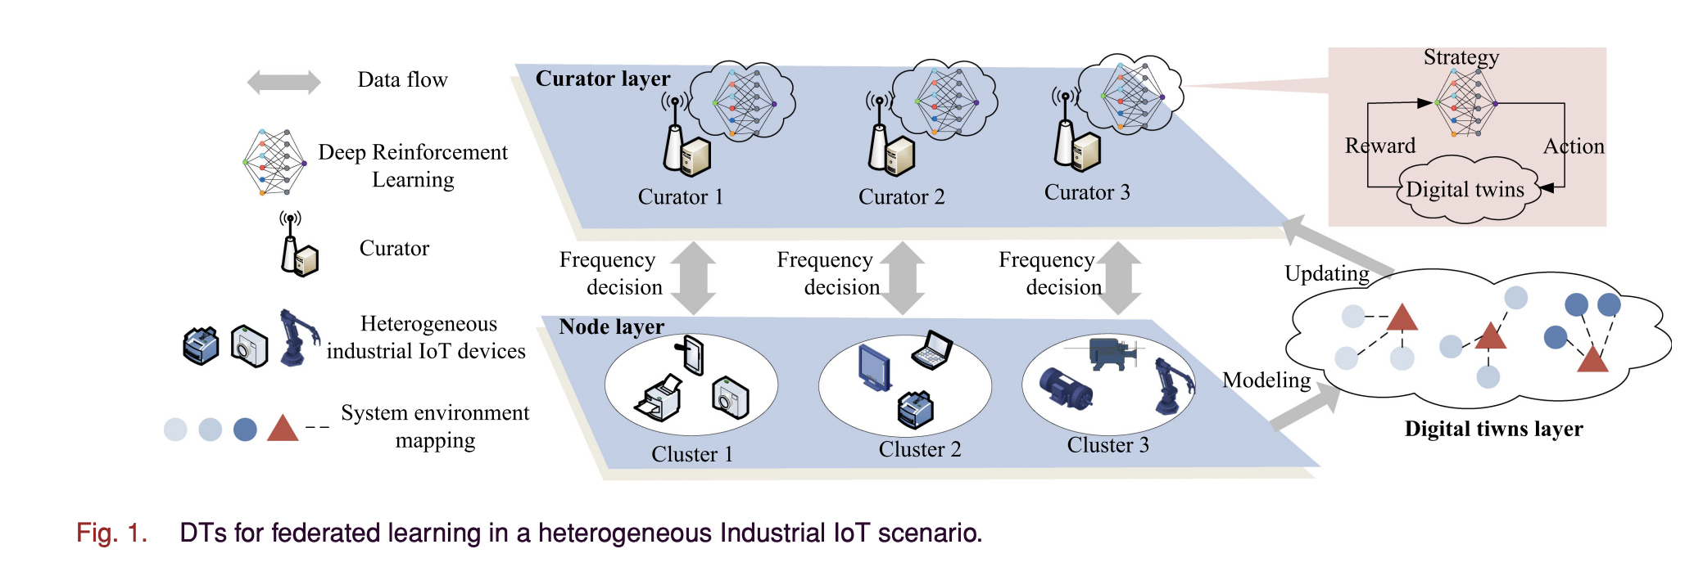
Not enough data - Model Aggregation
DTs capture the characteristics of industrial devices to assist federated learning.
DTs may bring estimation deviations from the actual value of device state, and a trusted-based aggregation is proposed in federated learning to alleviate the effects of such deviation.
Sun, Wen, et al. "Adaptive federated learning and digital twin for industrial internet of things." IEEE Transactions on Industrial Informatics 17.8 (2020): 5605-5614.

Slide 16
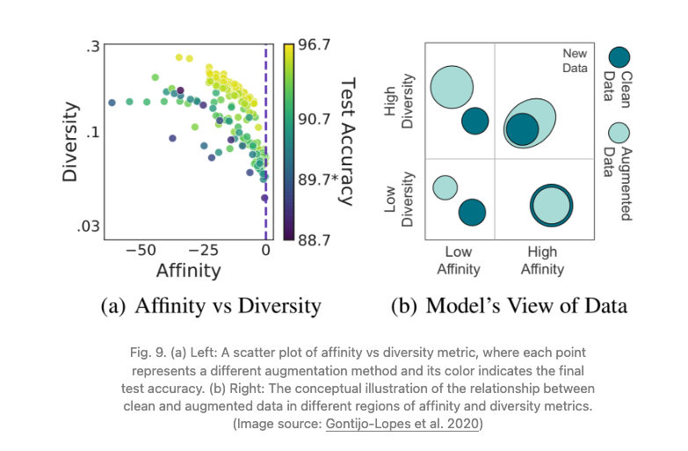
High-fidelity digital twin in terms of data quality
1. Affinity is a model-sensitive metric for distribution shift, quantifying how much an augmentation shifts the training data distribution from what a model learned.
2. Diversity is a measure of augmentation complexity, measuring the complexity of the augmented data with respect to the model and learning procedure.

Slide 17
Data are outdated
Low sampling rate
Communication resources limitation
Data freshness of digital twin

Slide 18
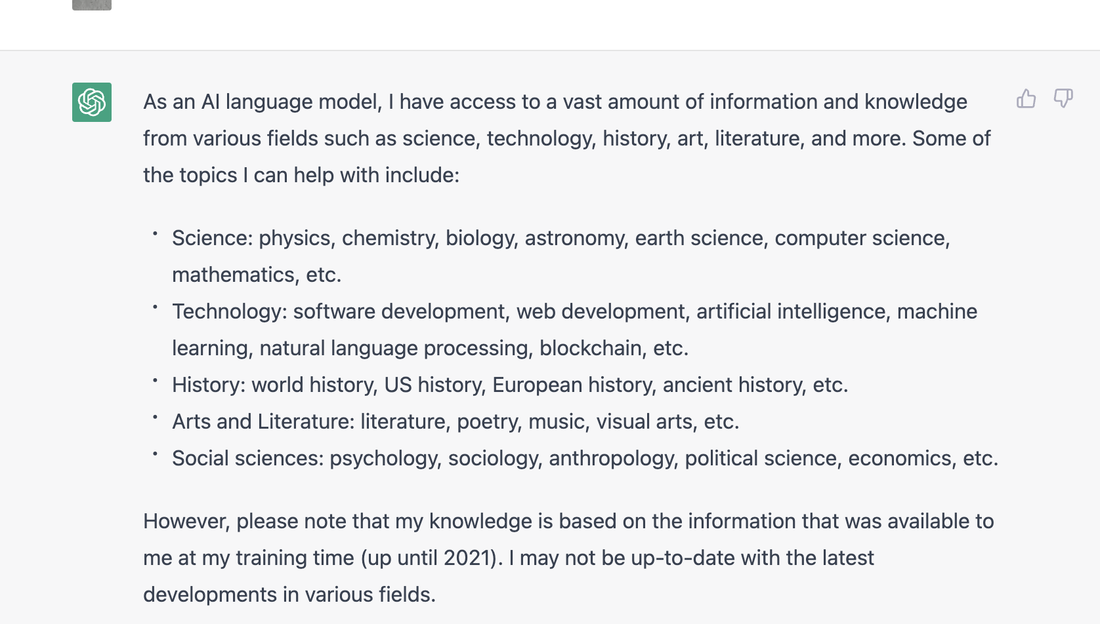
Data freshness of ChatGPT
For ChatGPT, the knowledge access is based on the information up until 2021.
For a high-fidelity DT, we expect this the data freshness can be as fresh as possible.

Slide 19
Importance of Data freshness
Data freshness play an important role in DTs:
Medical Care ( Status of Body)
Smart Home ( Status of sensors)
Internet of Vehicle (Status of transportation)
The high-fidelity data (e.g., fresh data) should be constantly in incorporated to enhance service quality
Challenges: A balance between

Slide 20
High-fidelity digital twin in terms of data freshness
1. Low sampling rate / data generation rate
Data fidelity - average time duration between two consecutive data generation
2. Communication resources are limited to capture the changes of all components
Reveal Delay - average time duration between the receival of a data and the generation of this data.
Find a strategy to increase the data fidelity and reveal delay of specific digital twins
Wang, Chenyu, Zhipeng Cai, and Yingshu Li. "Sustainable blockchain-based digital twin management architecture for IoT devices." IEEE Internet of Things Journal (2022).

Slide 21
Next work – Deep Reinforcement Learning from Crowds
The information in Crowd is heterogenous
1. Quality of data
Freshness;
Number of Training samples;
Label correctness.
2. Bias / Privacy of Crowds
We have seen many applications of learning from crowds in terms of classification problem. However, Rare studies of Creation of high-fidelity decision-making DTs are found.
We expect to develop the study of – Deep Reinforcement Learning from Crowds

